Slide 1
Math Club
Upcoming events
November or December Wa`ahila Ridge Trail hike
Monday, November 6th meeting in Keller 301, 4 to 5pm
First round of Math Off Tournament February 9th, 4 to 5pm
Available Positions
Arts and games curator
Treasurer
Contact us: mathclub@math.hawaii.edu
Check out our instagram: @uhm.mathclub

Slide 2
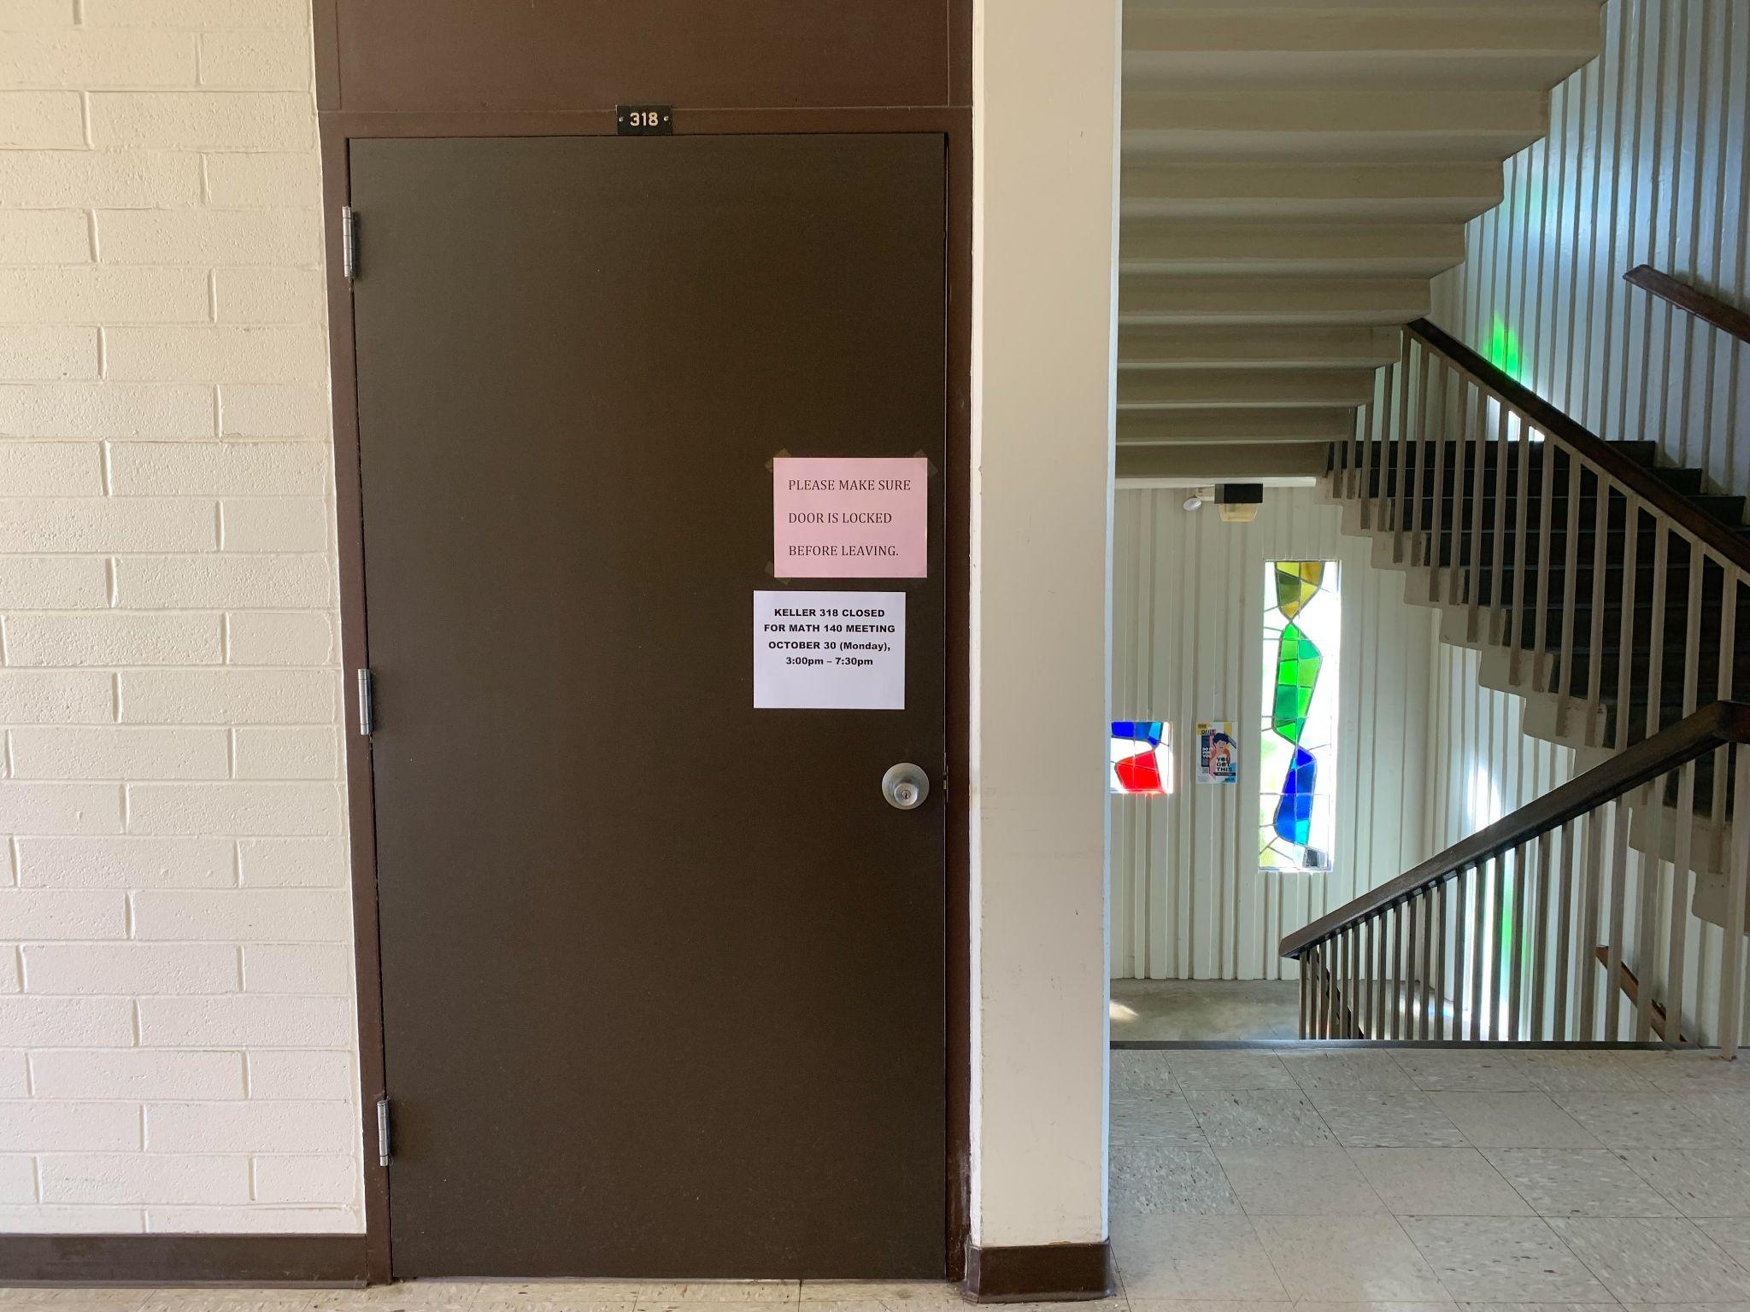
Math Undergraduate Lounge
(Keller 318)

